Slide 1
Somatic Simu
Mutational signature simulator for benchmarking alignment-free
machine learning classification of genomic signatures

Slide 2
Introduction
Mutation Signatures: overview
Somatic mutations in cancer genomes can have an exogenous and endogenous origin
Characteristic mutations lead to a signature
Signatures have unique identifying features that differ relative to other signatures
Figure 1. Catalogue of Mutations in Cancer Genomes
Source: https://software.broadinstitute.org/cancer/cga/msp

Slide 3
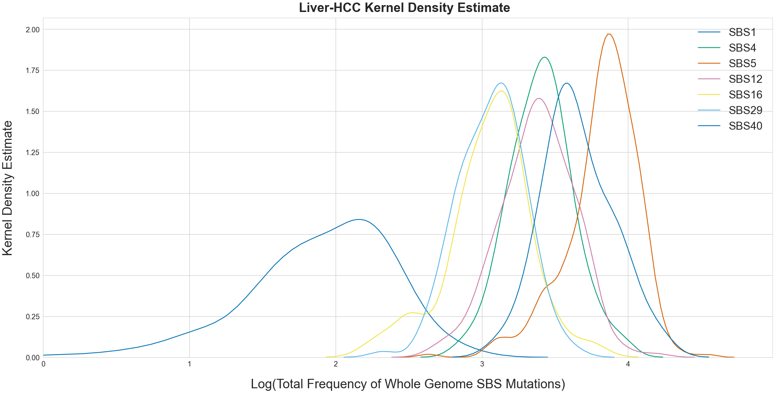
Introduction
Features of mutation signatures
Multiple mutational processes lead to superimposed signatures
Mathematical models estimate which mutations are attributed to which signature
Potential for classification
Figure 2. Kernel density estimate of total number of mutations
attributed to SBS mutational signatures operative in Liver-HCC

Slide 4
Literature
Single Base substitution classification (SBS-96)
C>G
A
C>T
A
96
SBS
Types
C
C>A
C
G
T>A
G
T
T>C
T
T>G

Slide 5
Research Proposal
Research proposal
Genomic signatures have proven to be useful as methods for taxonomic classification
Alignment-free machine learning approaches can classify at the species level
Source: https://www.nature.com/articles/s41598-018-38157-3
Source: https://bmcgenomics.biomedcentral.com/articles/10.1186/s12864-019-5571-y
To what degree of accuracy and sensitivity can alignment-free machine learning approaches classify cancer whole genomic signatures?

Slide 6
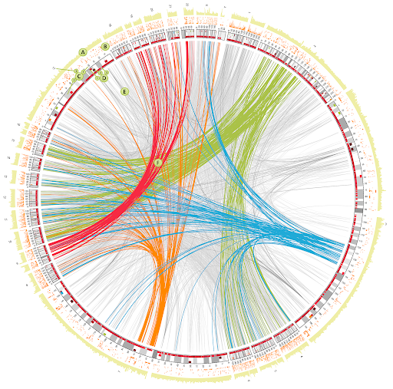

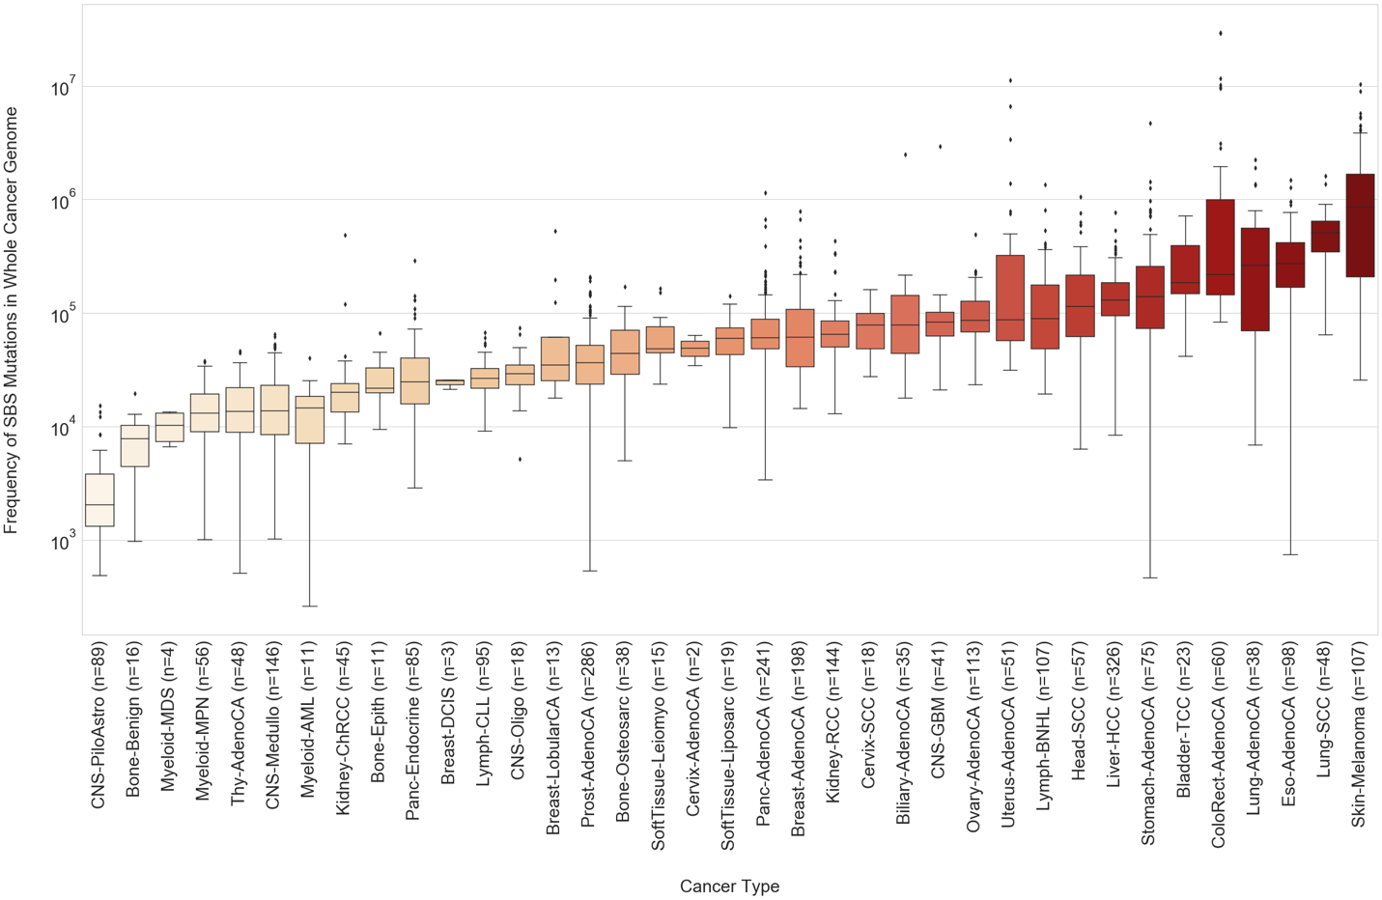
Methods
Somatic simu data pipeline
4 signature types:
SBS-96
DBS-78
Single Base Insertion
Single Base Deletion
2780 whole
cancer genomes
37 cancer types

Slide 7
Somatic SiMu
Use Case
Generated simulated sequences as fasta files with biologically representative frequencies of imposed SBS, DBS, and single base indels as a proof of concept for directed evolution simulation at the genomic signature level.
1
2
Artificial upsampling of minority classes to obtain a more balanced data distribution recommended for supervised machine learning.
3
Benchmark the alignment-free machine learning approach for sensitivity between different cancer types.
4
Benchmark alignment-free machine learning approaches for accuracy across successive stages of mutation signature simulation on the same sequence.

Slide 8
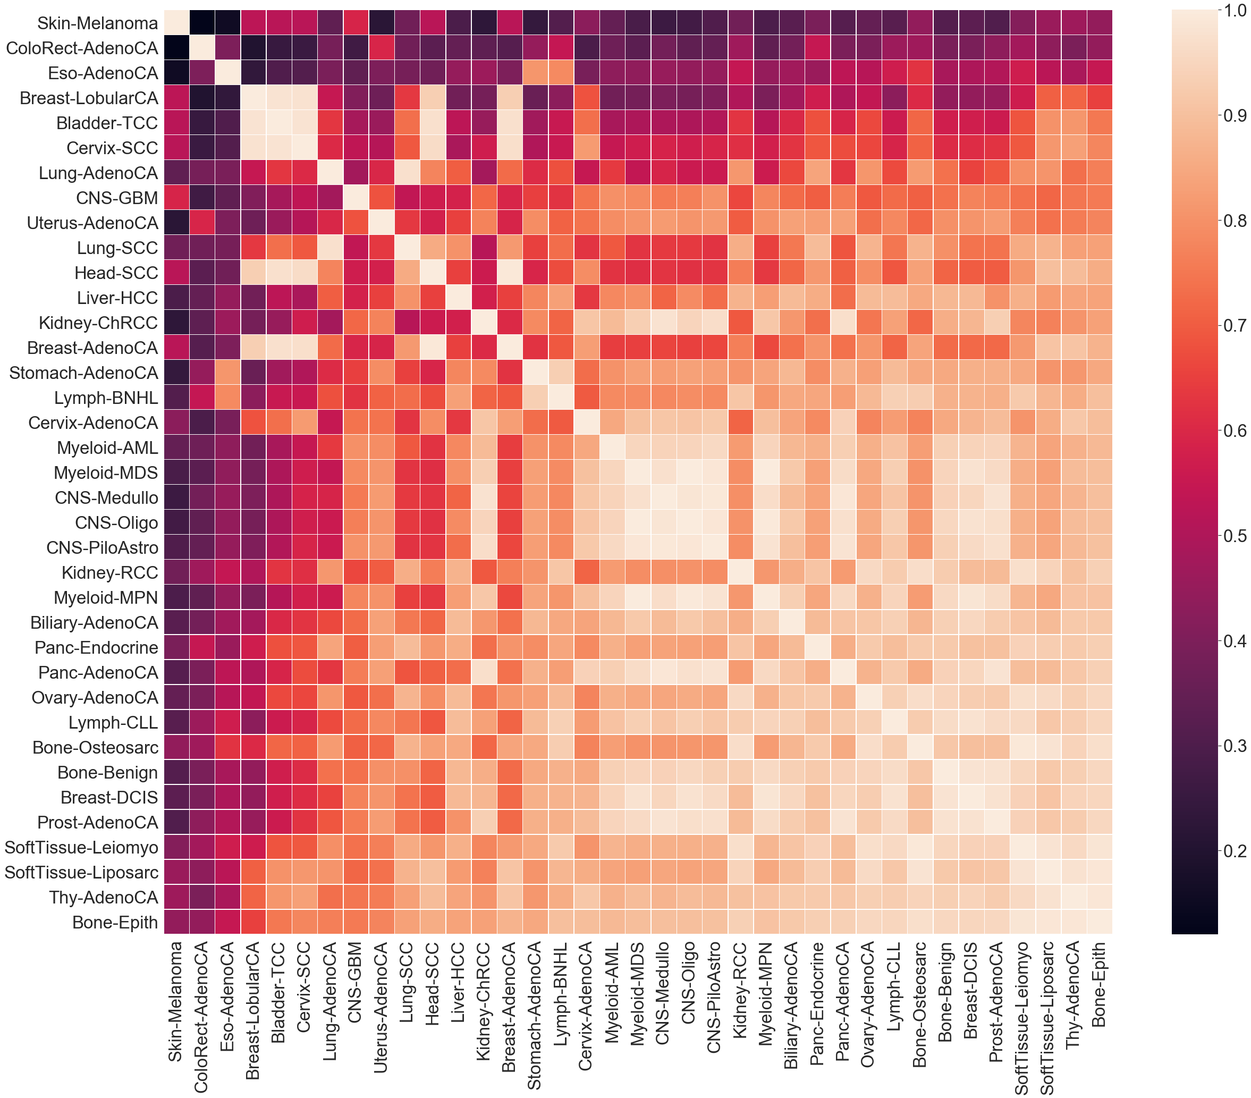
Methods
Cosine Similarity of SBS Mutation Probabilities
Cosine similarity is metric used to compare the similarity of a multidimensional metric
Higher score indicates higher similarity between cancer types and more similar evolutionary trajectories

Slide 9
Methods
SBS Mutation Burden in whole genome

Slide 10
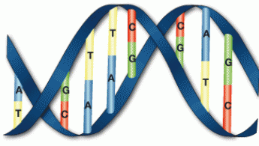
Methods
Parallel Directed evolution simulation
Stage 1
Stage 2
Cancer
Type Signatures

Slide 11
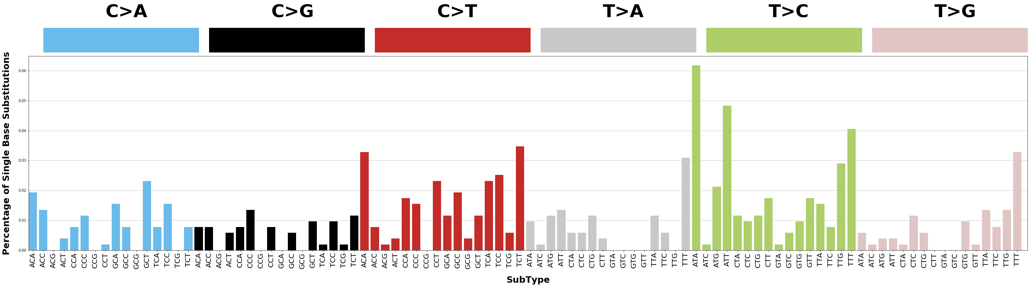
Results
Proof of concept
96-type SBS Mutation Catalogue of simulated mutations bootstrapped 100 times on Chromosome 22
Source: https://cancer.sanger.ac.uk/cosmic/signatures/

Slide 12
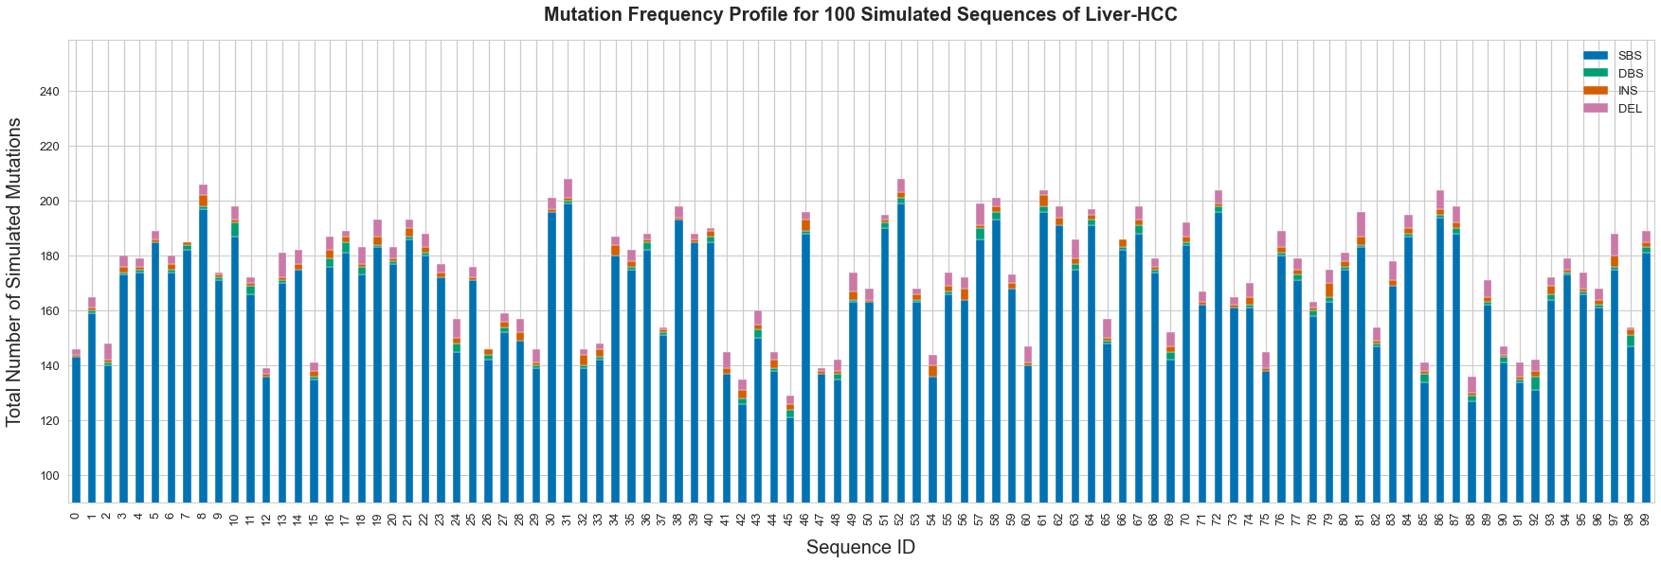
Results
Proof of concept
Counts of simulated SBS, DBS and indel mutations bootstrapped 100 times on Chromosome 22

Slide 13
Results
Hypothesis of MLDSP accuracy
High SBS Mutation Burden
Low SBS Mutation Burden
High SBS
Cosine Similarity
Low Accuracy
Low SBS
Cosine Similarity
High Accuracy

Slide 14
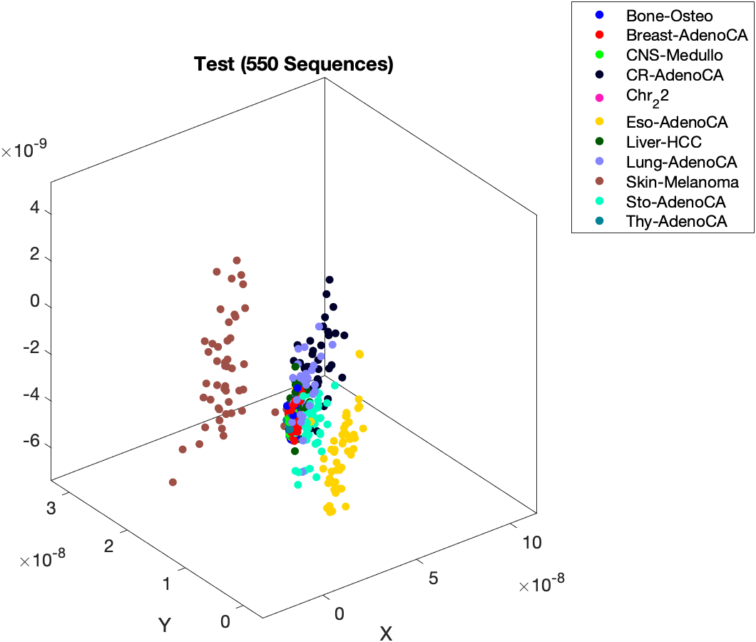
Results
Broad spectrum mldsp classification
Linear SVM: 81.5% Accuracy
Greater misclassification of cancer types with low total simulated mutational burden

Slide 15
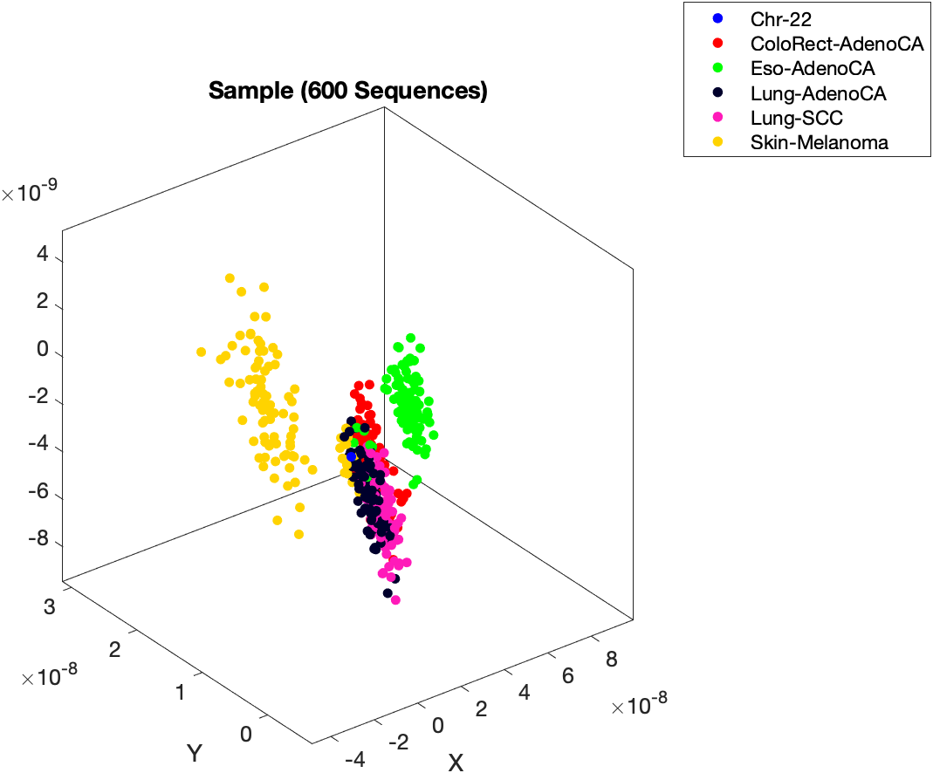
Results
High burden and Low similarity mldsp
Quadratic SVM: 96.5% Accuracy
High classification accuracy due to characteristic mutation types and high mutational burden
High Burden
Low Burden
High Sim.
Low Sim.
High Accuracy

Slide 16
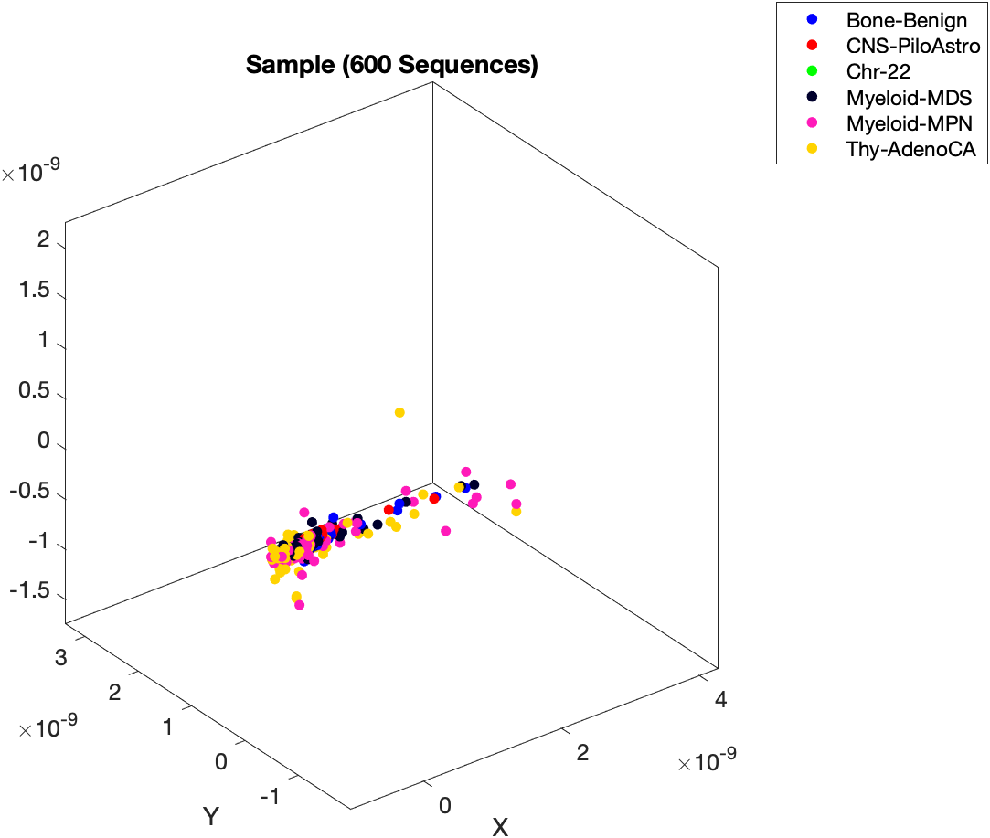
Results
Low burden and High similarity mldsp
Linear SVM: 62.7% Accuracy
Low classification accuracy due to low mutational burden
High Burden
Low Burden
High Sim.
Low Accuracy
Low Sim.

Slide 17
Results
Low burden and low similarity mldsp
Linear SVM: 64.2% Accuracy
Low classification accuracy due to low mutational burden
Small increase in accuracy due to low similarity
High Burden
Low Burden
High Sim.
Low Sim.

Slide 18
Results
High burden and High similarity mldsp
Linear SVM: X
High Burden
Low Burden
High Sim.
Low Sim.

Slide 19
Results
Conclusion
Somatic SiMu can simulate sequences as fasta files with biologically representative frequencies of imposed SBS, DBS, and single base indels as a proof of concept for directed evolution simulation at the genomic signature level.
1
2
Simulated sequences can be used to upsample minority classes to obtain a more balanced data distribution recommended for supervised machine learning.
3
Machine learning with digital signal processing achieves high accuracy in supervised machine learning classification of simulated cancer sequences at the sub-species level with high mutational burden and unique mutations.
4
Machine learning with digital signal processing reports lower accuracy in supervised machine learning classification of simulated cancer sequences with low mutational burden.

